Slide 1
Library QC for ONT metagenomics
Rapid Response – Updated January 2026

Slide 2
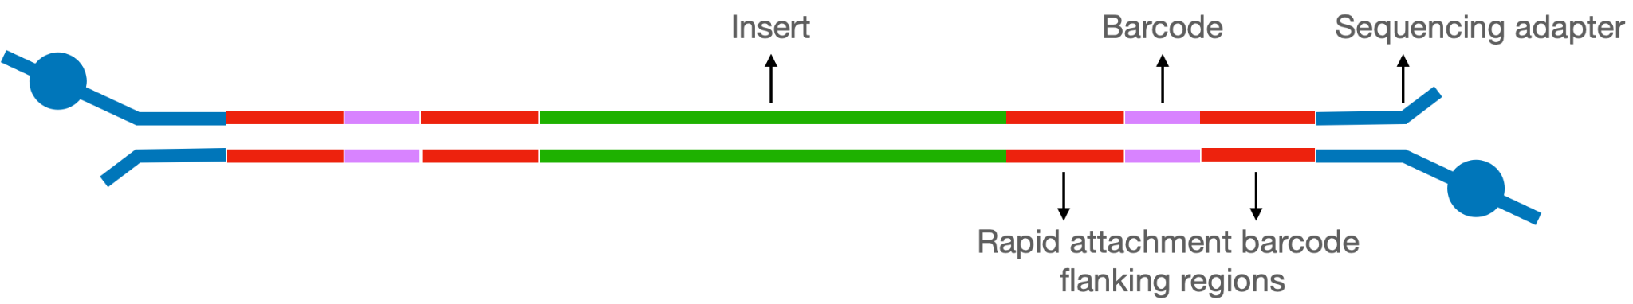
Library Quality Control (QC)
The purpose of QC is to ensure that there is sufficient and good quality library for sequencing.
Quantity (concentration)
  Amount of library is measured using Qubit (or other fluorescence based method)
Quality (length)
  Measured using capillary electrophoresis (Tapestation, Bioanalyzer, Fragment Analyzer)
  If capillary electrophoresis is unavailable, regular gel electrophoresis may be used with a diagnostic PCR

Slide 3
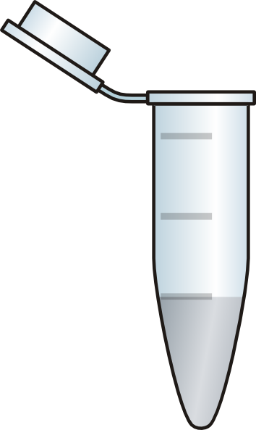

Overview of Library QC
QC 1
Sample A
Individual library QC passed?
YES
QC 2
YES
Final QC
passed?
Individual library QC passed?
Pool
YES
Sample B
YES
Water control A
Individual library QC passed?
Notes:
Two moments during lib prep to do QC: individual library and pooled library

Slide 4

Library prep QC
Concentration
Length
Remove adapter dimers
vs
vs
vs
or

Slide 5
Assessing concentration is important for
even pooling and accurate loading
Why is an accurate concentration important?
Individual samples: to pool equal amounts of different samples together
  Aim for an even amount of sequencing data per sample
Final library: The total amount of final library needs to be within a specific range*
  For the MinION 10.4 flow cell, this range is 10-50 fmol
    We have found that 100-150 fmol works best
*Nanopore is more forgiving than Illumina in accommodating a wider range of input loading amounts and we find that loading more than 50 fmol works well

Slide 6
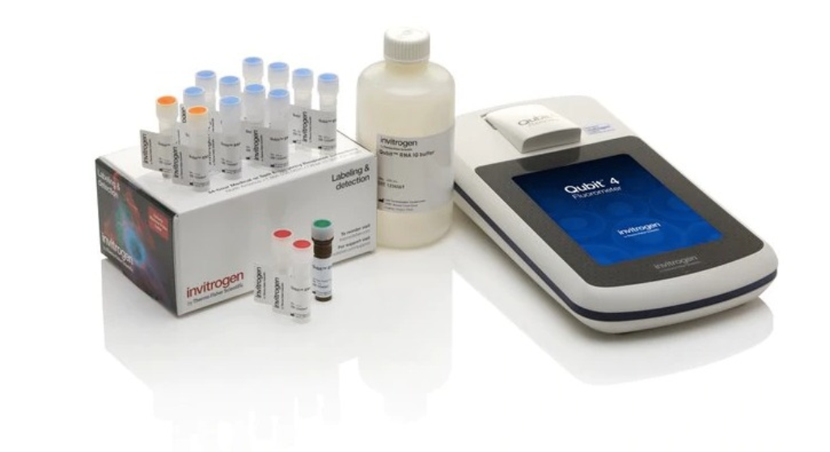
Library concentration is best assessed using fluorometry like Qubit
✓
Fluorometry
(e.g. Qubit)
Use for concentration
Detects fluorescent dyes that only bind DNA
Notes:
RNA, guanidine

Slide 7
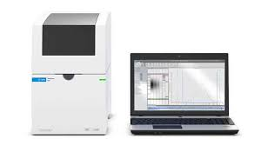
Library concentration is best assessed using fluorometry like Qubit
✓
Fluorometry
(e.g. Qubit)
Use for concentration
Electrophoresis
(e.g. QSep, Tapestation, Bioanalyzer, gel)
Detects fluorescent dyes that only bind DNA
Compare intensity of DNA bands to standards
Especially useful to determine concentration in certain fragment length range
✓
Use for size profiling (“quality”) and molar concentrations (for pooling)
Notes:
RNA, guanidine

Slide 8
Bioanalyzer or Tapestation may be used for pooling, if necessary
✓
Fluorometry
(e.g. Qubit)
Use for concentration
Electrophoresis
(e.g. QSep, Tapestation, Bioanalyzer, gel)
Detects fluorescent dyes that only bind DNA
Compare intensity of DNA bands to standards
Especially useful to determine concentration in certain fragment length range
✓
Use for size profiling (“quality”) and molar concentrations (for pooling)
Notes:
RNA, guanidine

Slide 9
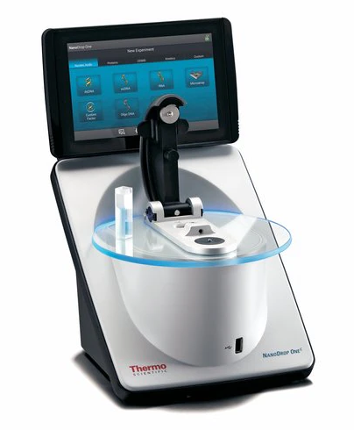
Nanodrop is not recommended for assessing concentration
Spectrophotometry
(e.g. Nanodrop)
DNA absorbs light most strongly at 260 nm
Level of absorbance ~ concentration of DNA
BUT other molecules (RNA, proteins) & contaminants also absorb light at 260 nm, causing up to 10-fold overestimation of the DNA concentration!
✘
Do not use for concentration
✓
Use for detecting contaminants
Notes:
RNA, guanidine

Slide 10
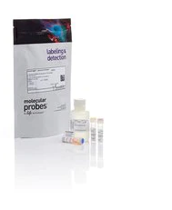
How to use the Qubit
Qubit dsDNA High Sensitivity (HS) Assay kit
Prepare Working Solution:
  Diluting HS reagent 1:200 in HS buffer
Dilute in Working Solution:
  Standards: 10 μl standard + 190 μl Working Solution
  Samples: 1 μl sample + 199 μl Working Solution
Vortex 2-3 seconds before running standards/samples
dsDNA HS Reagent (200x concentrate)
dsDNA HS Buffer
dsDNA HS Standard #1
dsDNA HS Standard #2

Slide 11
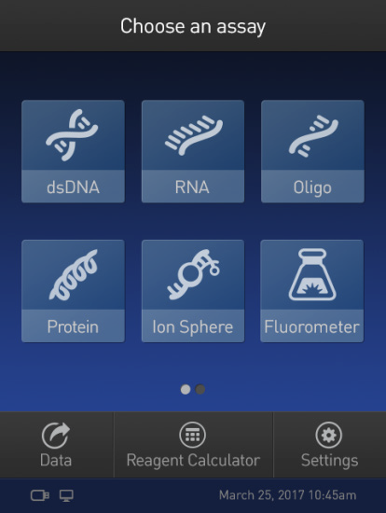
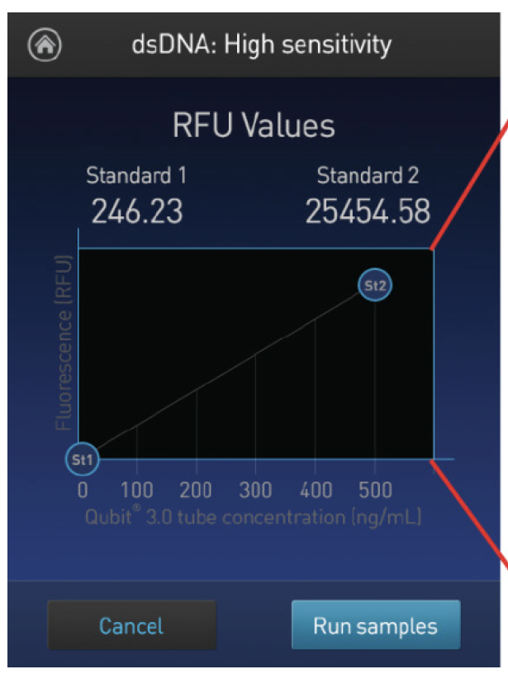
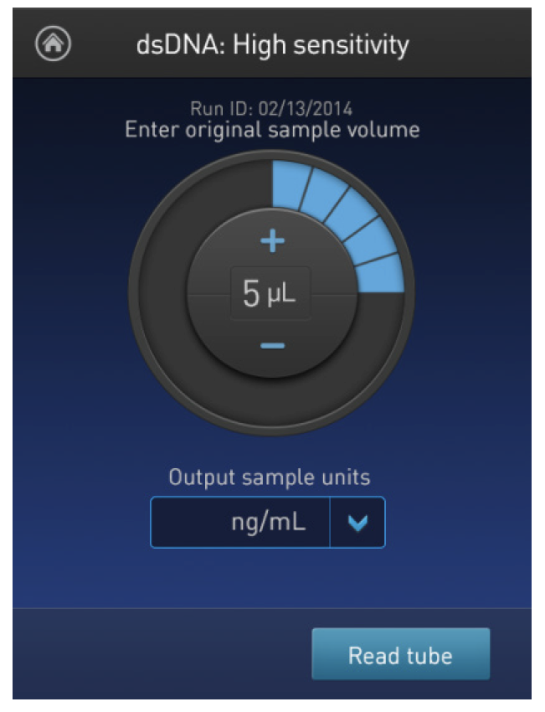
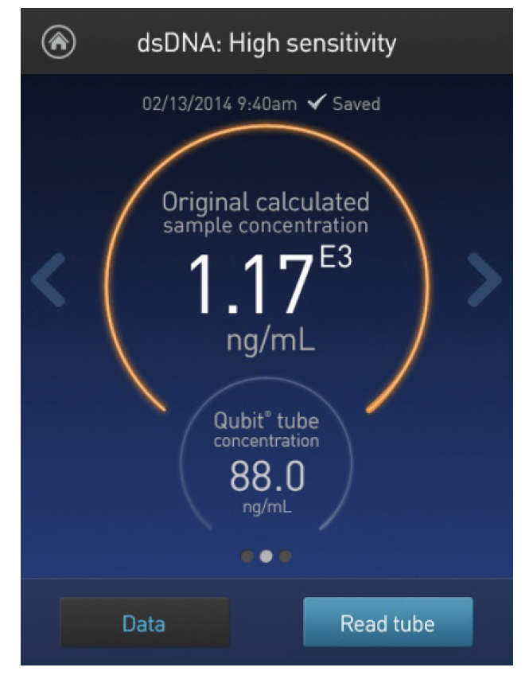
How to use the Qubit
Qubit dsDNA High Sensitivity (HS) Assay kit
Select dsDNA HS workflow
Run the 2 standards
Enter sample volume added to tube
Run sample
Top value = original conc.
Bottom value = diluted conc.

Slide 12
Library prep QC
Concentration
Length
Remove adapter dimers
vs
vs
vs
or
Notes:
Update to protocol: Ct <15: dilute 1/10, rest use undiluted

Slide 13
Assessing length can provide insight to the quality of the library:
Is the library good enough to load?
Why is it important to assess library size distribution?
Depending on sample quality, there can be huge variations in the library size (100s of bases to 1000s of bases)
Non-specific products can sometimes be formed
  Primer/oligo dimers when high input cDNA concentrations are used
  Long concatemers that can block pores and reduce sequencing output (~10kb or more)
Fragment length distribution impacts molarity calculations for pooling and sequencer loading
  Convert from ng/μl (Qubit) + Length bp to nM (fmol/µL)

Slide 14
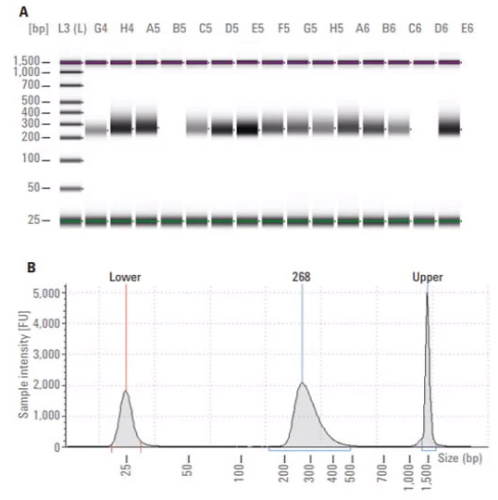
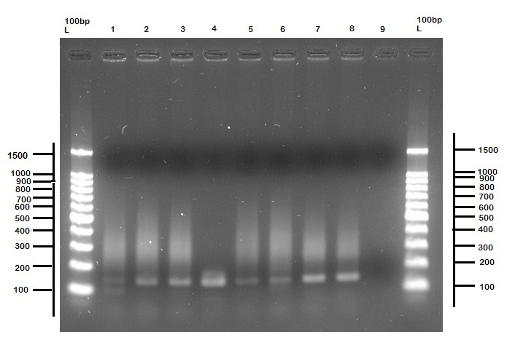
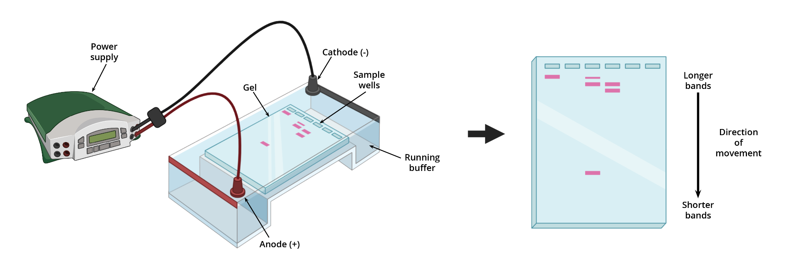
Library size is assessed with electrophoresis methods
How to assess library size distribution?
Capillary electrophoresis
E.g. Tapestation, Bioanalyzer
Gel electrophoresis
Add buffer to aliquot of library
Run machine
PCR amplify an aliquot of the library using “universal” primers
Gel electrophoresis of ladder and samples
Tapestation ~ 10-20 minutes
Bioanalyzer ~ 45 minutes
No PCR bias
Can calculate concentration in nM
Takes ~ 4 hrs
Does not require specialized equipment
Tends to slightly overestimate library size

Slide 15
Diagnostic PCR method
Take 1 uL of the individual libraries or final pool and perform a standard PCR reaction for 20 cycles
Note: the PCR product will only be used for diagnostic QC, not for sequencing
For each sample or pool, setup the amplification reaction as follows:
Component | Volume (µL)
LongAmp Master Mix (2x) | 25
Nuclease-free Water | 23.5
RLB-PCR Primer* (10µM) | 0.5
DNA Library Template | 1
Total Volume | 50
*This primer is only for diagnostic PCR
Use the following cycling conditions:
Thermocycler (lid at 105˚C) | Cycles
95 °C for 45s | 1
95 ˚C for 15s | 20
56 ˚C for 15s
65 °C for 5 min
65˚C for 10 mins | 1
Hold at 10˚C | ∞
CZ Biohub Protocols: Nanopore mNGS
Run PCR amplified product on a gel to visualize and estimate the library size.

Slide 16
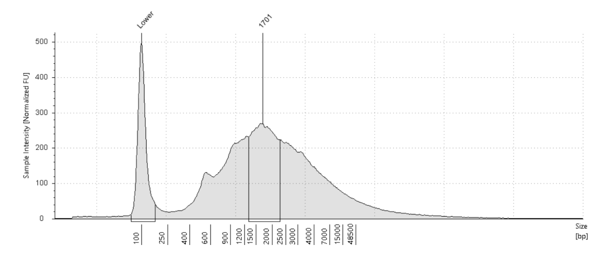
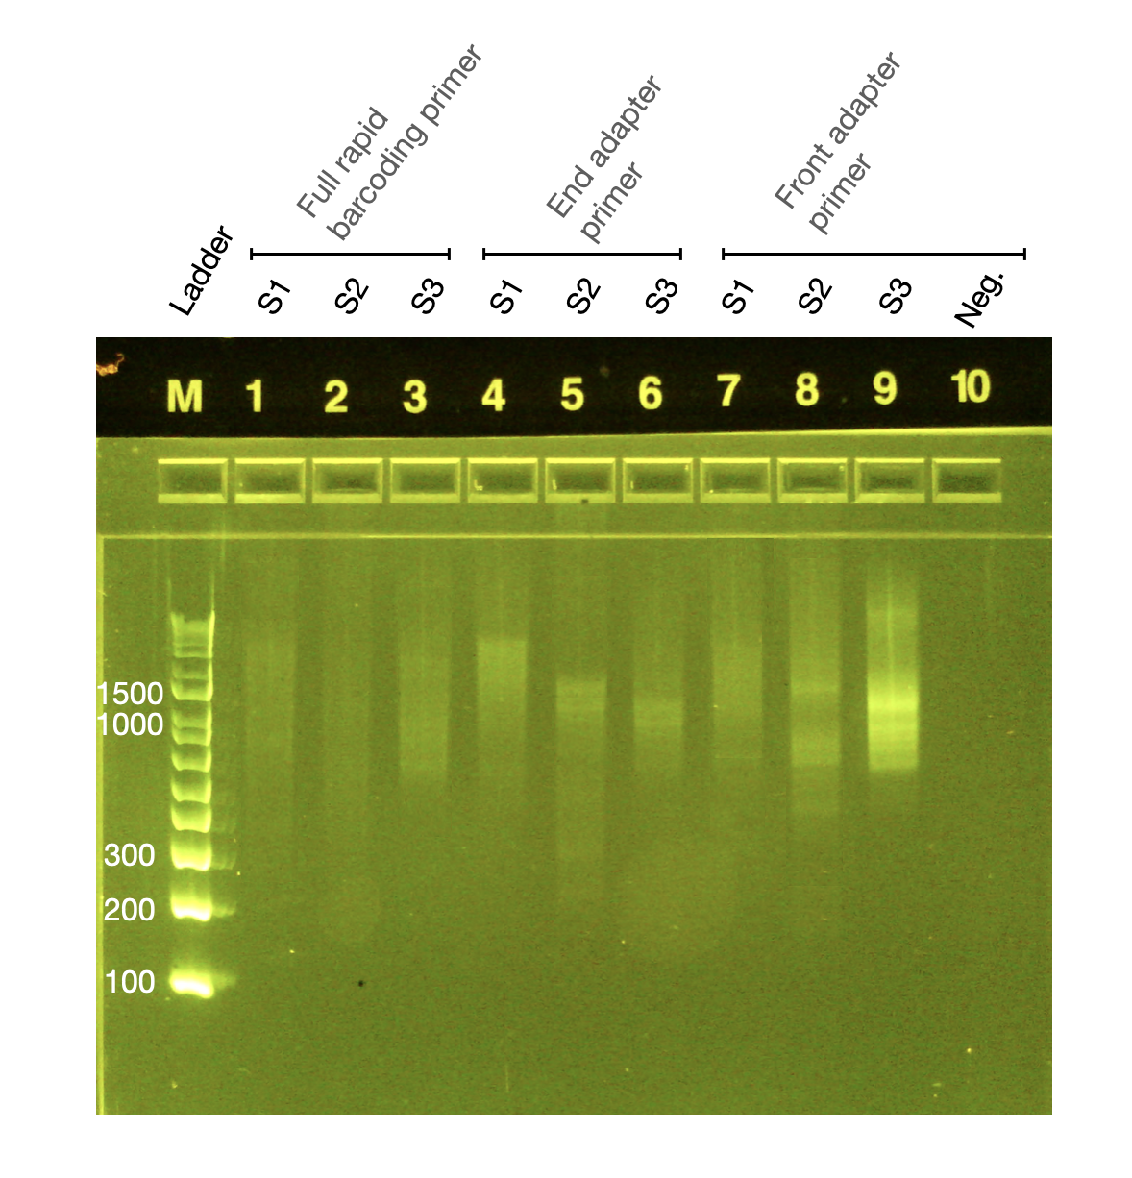
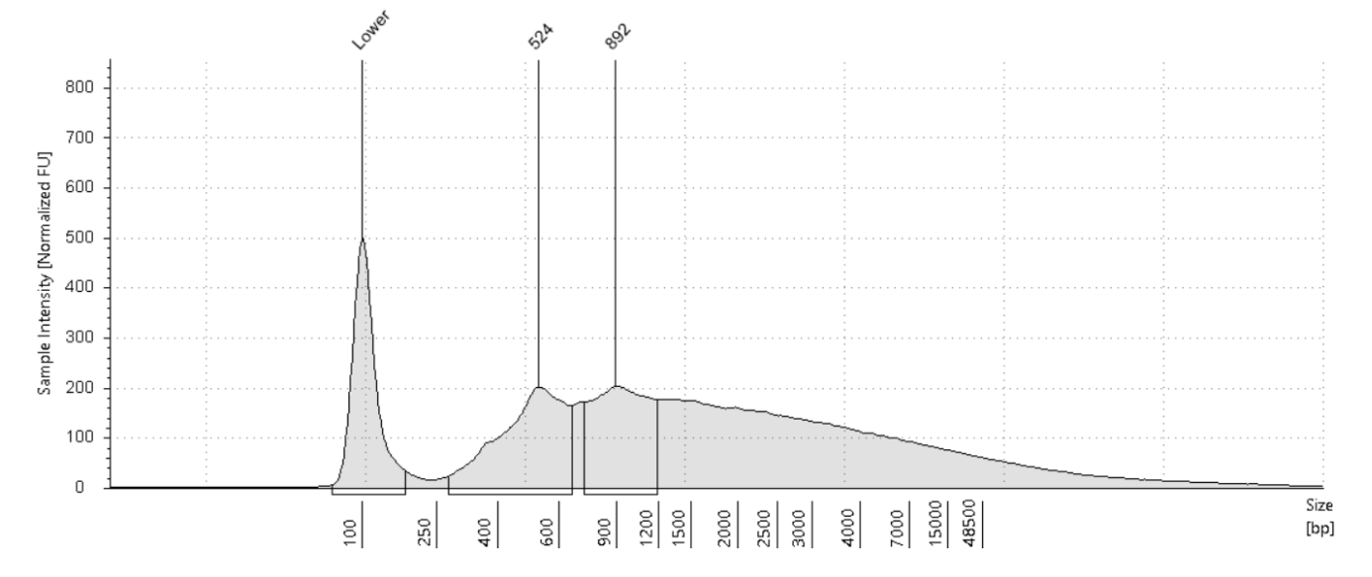
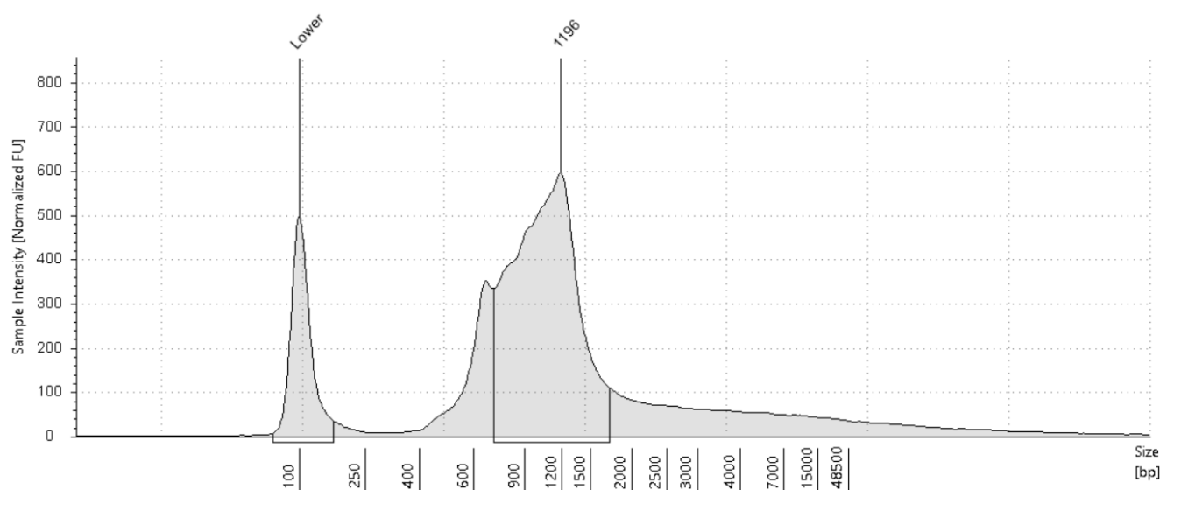
Diagnostic PCR results compared to Tapestation
1 2 3 Neg
1
~1700bp
2
~900bp
3
~1200bp

Slide 17
Library size is assessed with electrophoresis methods
How to assess library size distribution?
Capillary electrophoresis
E.g. Tapestation, Bioanalyzer
Gel electrophoresis
Add buffer to aliquot of library
Run machine
PCR amplify an aliquot of the library using “universal” primers
Gel electrophoresis of ladder and samples
Tapestation ~ 10-20 minutes
Bioanalyzer ~ 45 minutes
No PCR bias
Can calculate concentration in nM
Takes ~ 4 hrs
Does not require specialized equipment

Slide 18
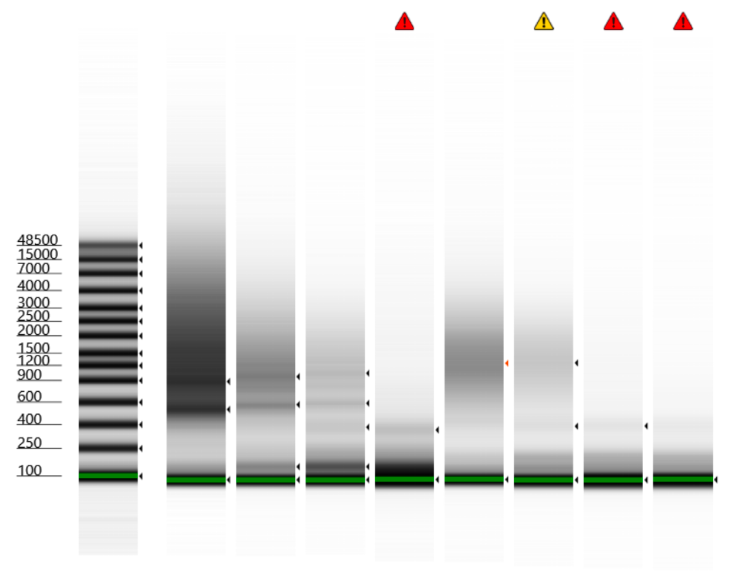
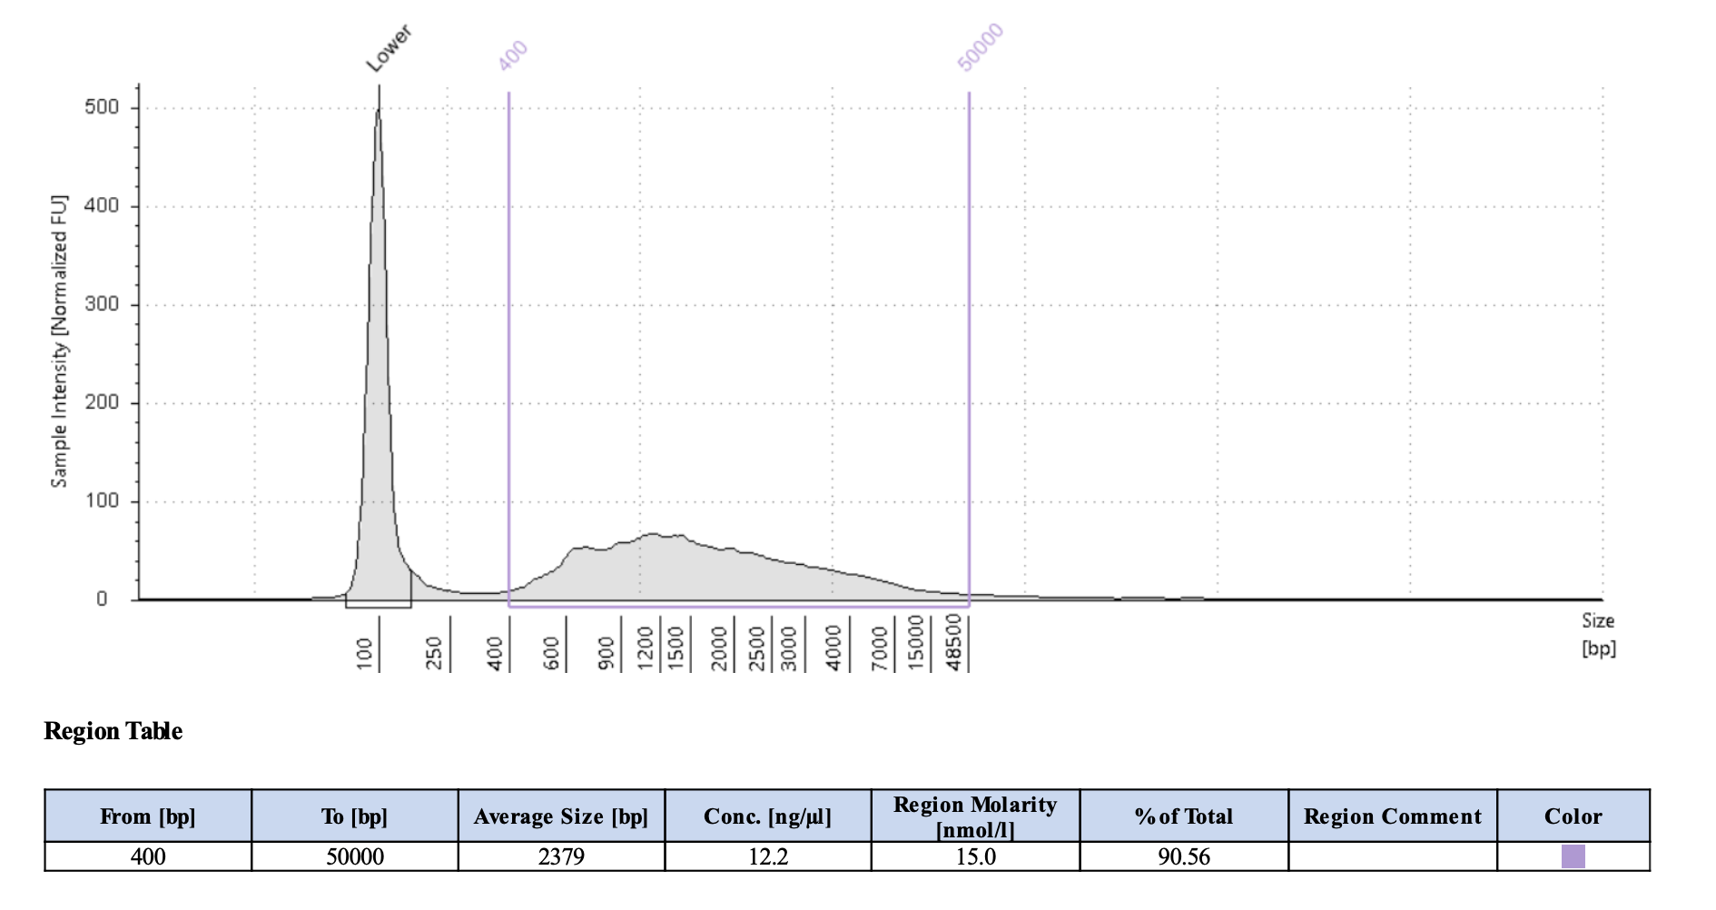
Tapestation genomic DNA kit can be used to assess library size
Tapestation
Genomic DNA kit is most suitable since fragments can be 1000s of bases long
✓

Slide 19
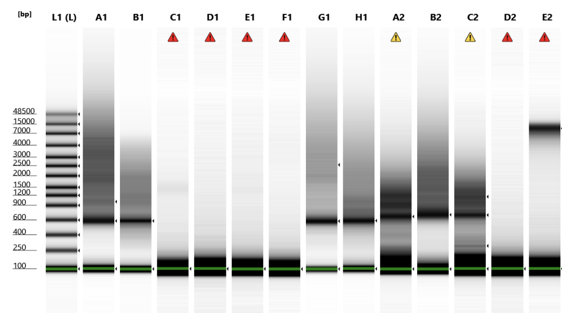
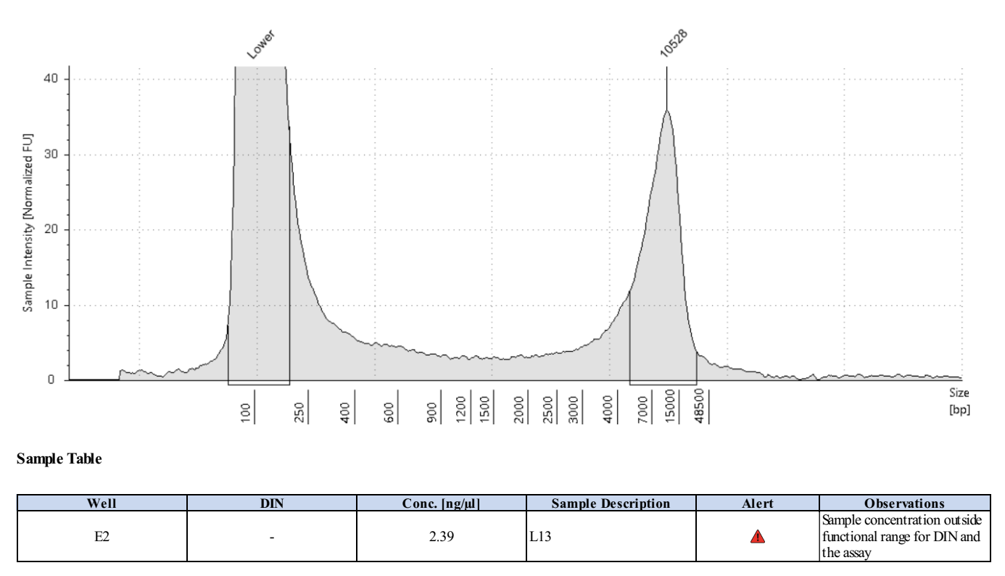
Look out for ~10kb concatemer artifacts - they will clog the flow cell pores
Tapestation
Genomic DNA kit is most suitable since fragments can be 1000s of bases long
Concatemer peak at ~10kb, with no other peaks*
✘
*Consider the input going in, and the library size you would expect. In this case, a 10kb peak was seen for RNA input, which is much longer than the fragment size we’d expect. It turns out that the 10kb peak was a concatemer artifact created during barcoding PCR.

Slide 20
Library size
Checking library size is important for troubleshooting
It is recommended to routinely check library size when establishing the protocol or expanding to new sample types
If results are consistent and sample type / source are constant, it is possible for the library size to be estimated
Size may be evaluated by:
  Diagnostic PCR + gel electrophoresis
  QSep / Tapestation / Bioanalyzer / Fragment analyzer
Size will be used for concentration calculation

Slide 21
Library prep QC
Concentration
Length
Remove adapter dimers
vs
vs
vs
or
Notes:
Update to protocol: Ct <15: dilute 1/10, rest use undiluted

Slide 22
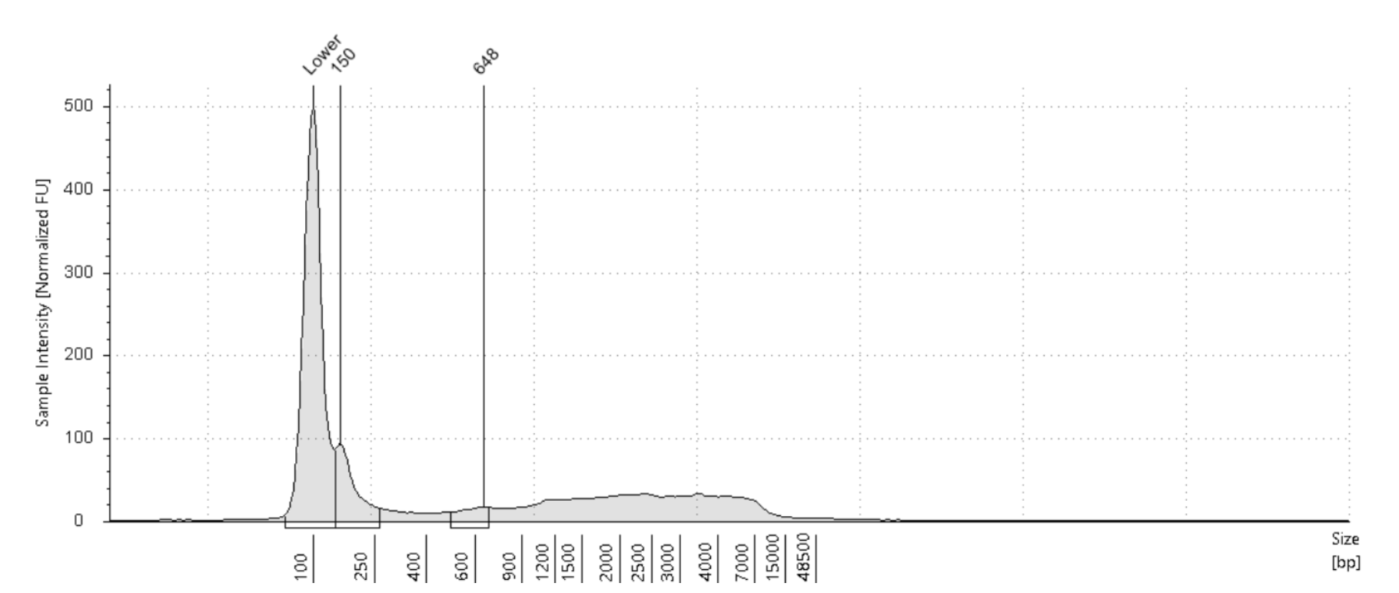
Library prep QC - Clean up primer/oligo dimers
Primer/oligo dimers:
  Occur when primers and unused 9N and TSO oligos interact during the PCR amplification
  Will not be informative if sequenced
Primer/oligo dimer peak

Slide 23
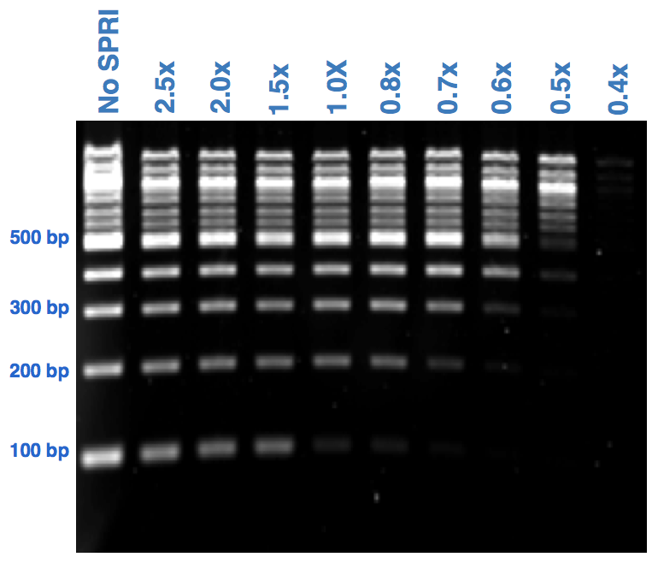
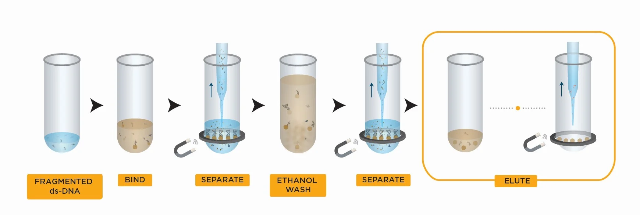
SPRI beads may be used to remove adapters and reagents
SPRIselect or AMPure XP SPRI select beads (paramagnetic)
The longer a fragment, the better it will bind to the beads
The fewer beads you add, the more short fragments you’ll lose
Perform size selection using these beads to remove adapter dimers
Volume beads
Volume reaction
SPRI ratio =
Example: for a 1.8x SPRI clean-up:
Add 18 μl of SPRI beads to 10 μl of sample
1. Bind DNA to magnetic beads; 2. Separate beads from contaminants;
3. Wash magnetic beads with 85% ethanol to remove contaminants;
4. Elute DNA from magnetic beads; 5. Transfer sample to new tube

Slide 24
Library prep QC - Clean up adapter dimers
AMPure XP SPRI select beads (paramagnetic)
Size selection using SPRI beads to remove adapter dimers
Samples can first be pooled and then a 0.6x SPRI clean-up can be performed

Slide 25
Library prep QC
How to fix samples with QC issues?
Concentration too low -> amplify or restart
Adapter dimers -> perform additional cleanups
Concatemer artifact observed -> restart
Fix it
NO
Sample A
Individual library QC passed?
Fix it
YES
NO
YES
Final QC
passed?
Individual library QC passed?
Pool
YES
Sample B
YES
Water control A
Individual library QC passed?
Notes:
Two moments during lib prep to do QC: individual library and pooled library

Slide 26
How much concentration do I really need?
Final pool
  Need 100-150 fmol to load the flow cell
  = 11ul of 10-15nM
Individual samples:
  Ideally individual samples would also have 10-15nM
    (7-10ng/ul for 1000bp library)
    (13-20ng/ul for 2000bp library)
  Total mass (ng) per sample added to pool will depend on:
    library size
    # of samples in the pool

Slide 27
Using the Tapestation

Slide 28
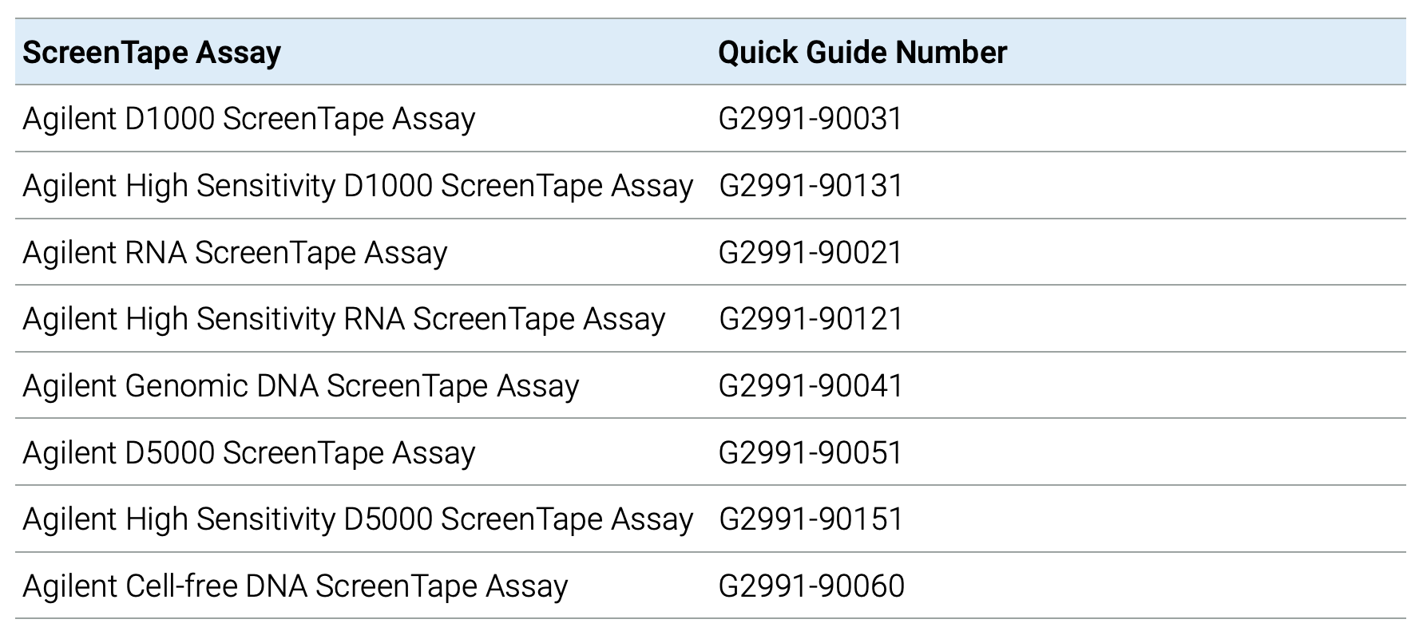
Choosing the right assay according to your starting material
RNA
500 – 10000 pg/µL
DNA
200 to >60000 bp, 10 – 100 ng/µL
Sequencing libraries
100 - 5,000 bp, 10 - 1,000 pg/µL
Note, sensitivity is guided by input concentration.

Slide 29
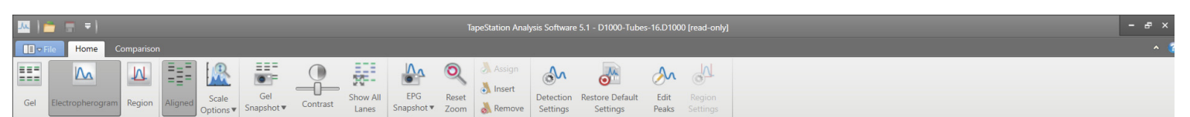
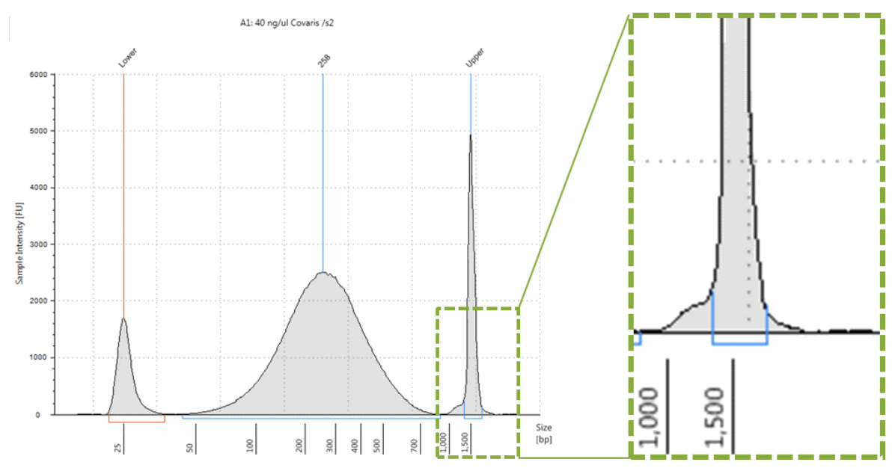
How to analyse a TapeStation run?
Ensure that all marker peaks (‘Lower’ and ‘Upper’) are properly assigned. Concentration values are calculated using the area of the sample peak compared to the known concentration of the upper marker.

Slide 30
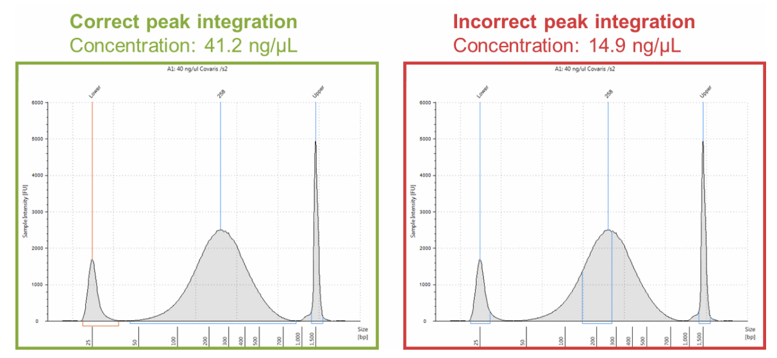
How to analyse a TapeStation run?
Ensure that all marker peaks (‘Lower’ and ‘Upper’) are properly assigned. Concentration values are calculated using the area of the sample peak compared to the known concentration of the upper marker.
Ensure that sample peaks are properly integrated by manually adjusting the peak when necessary.

Slide 31
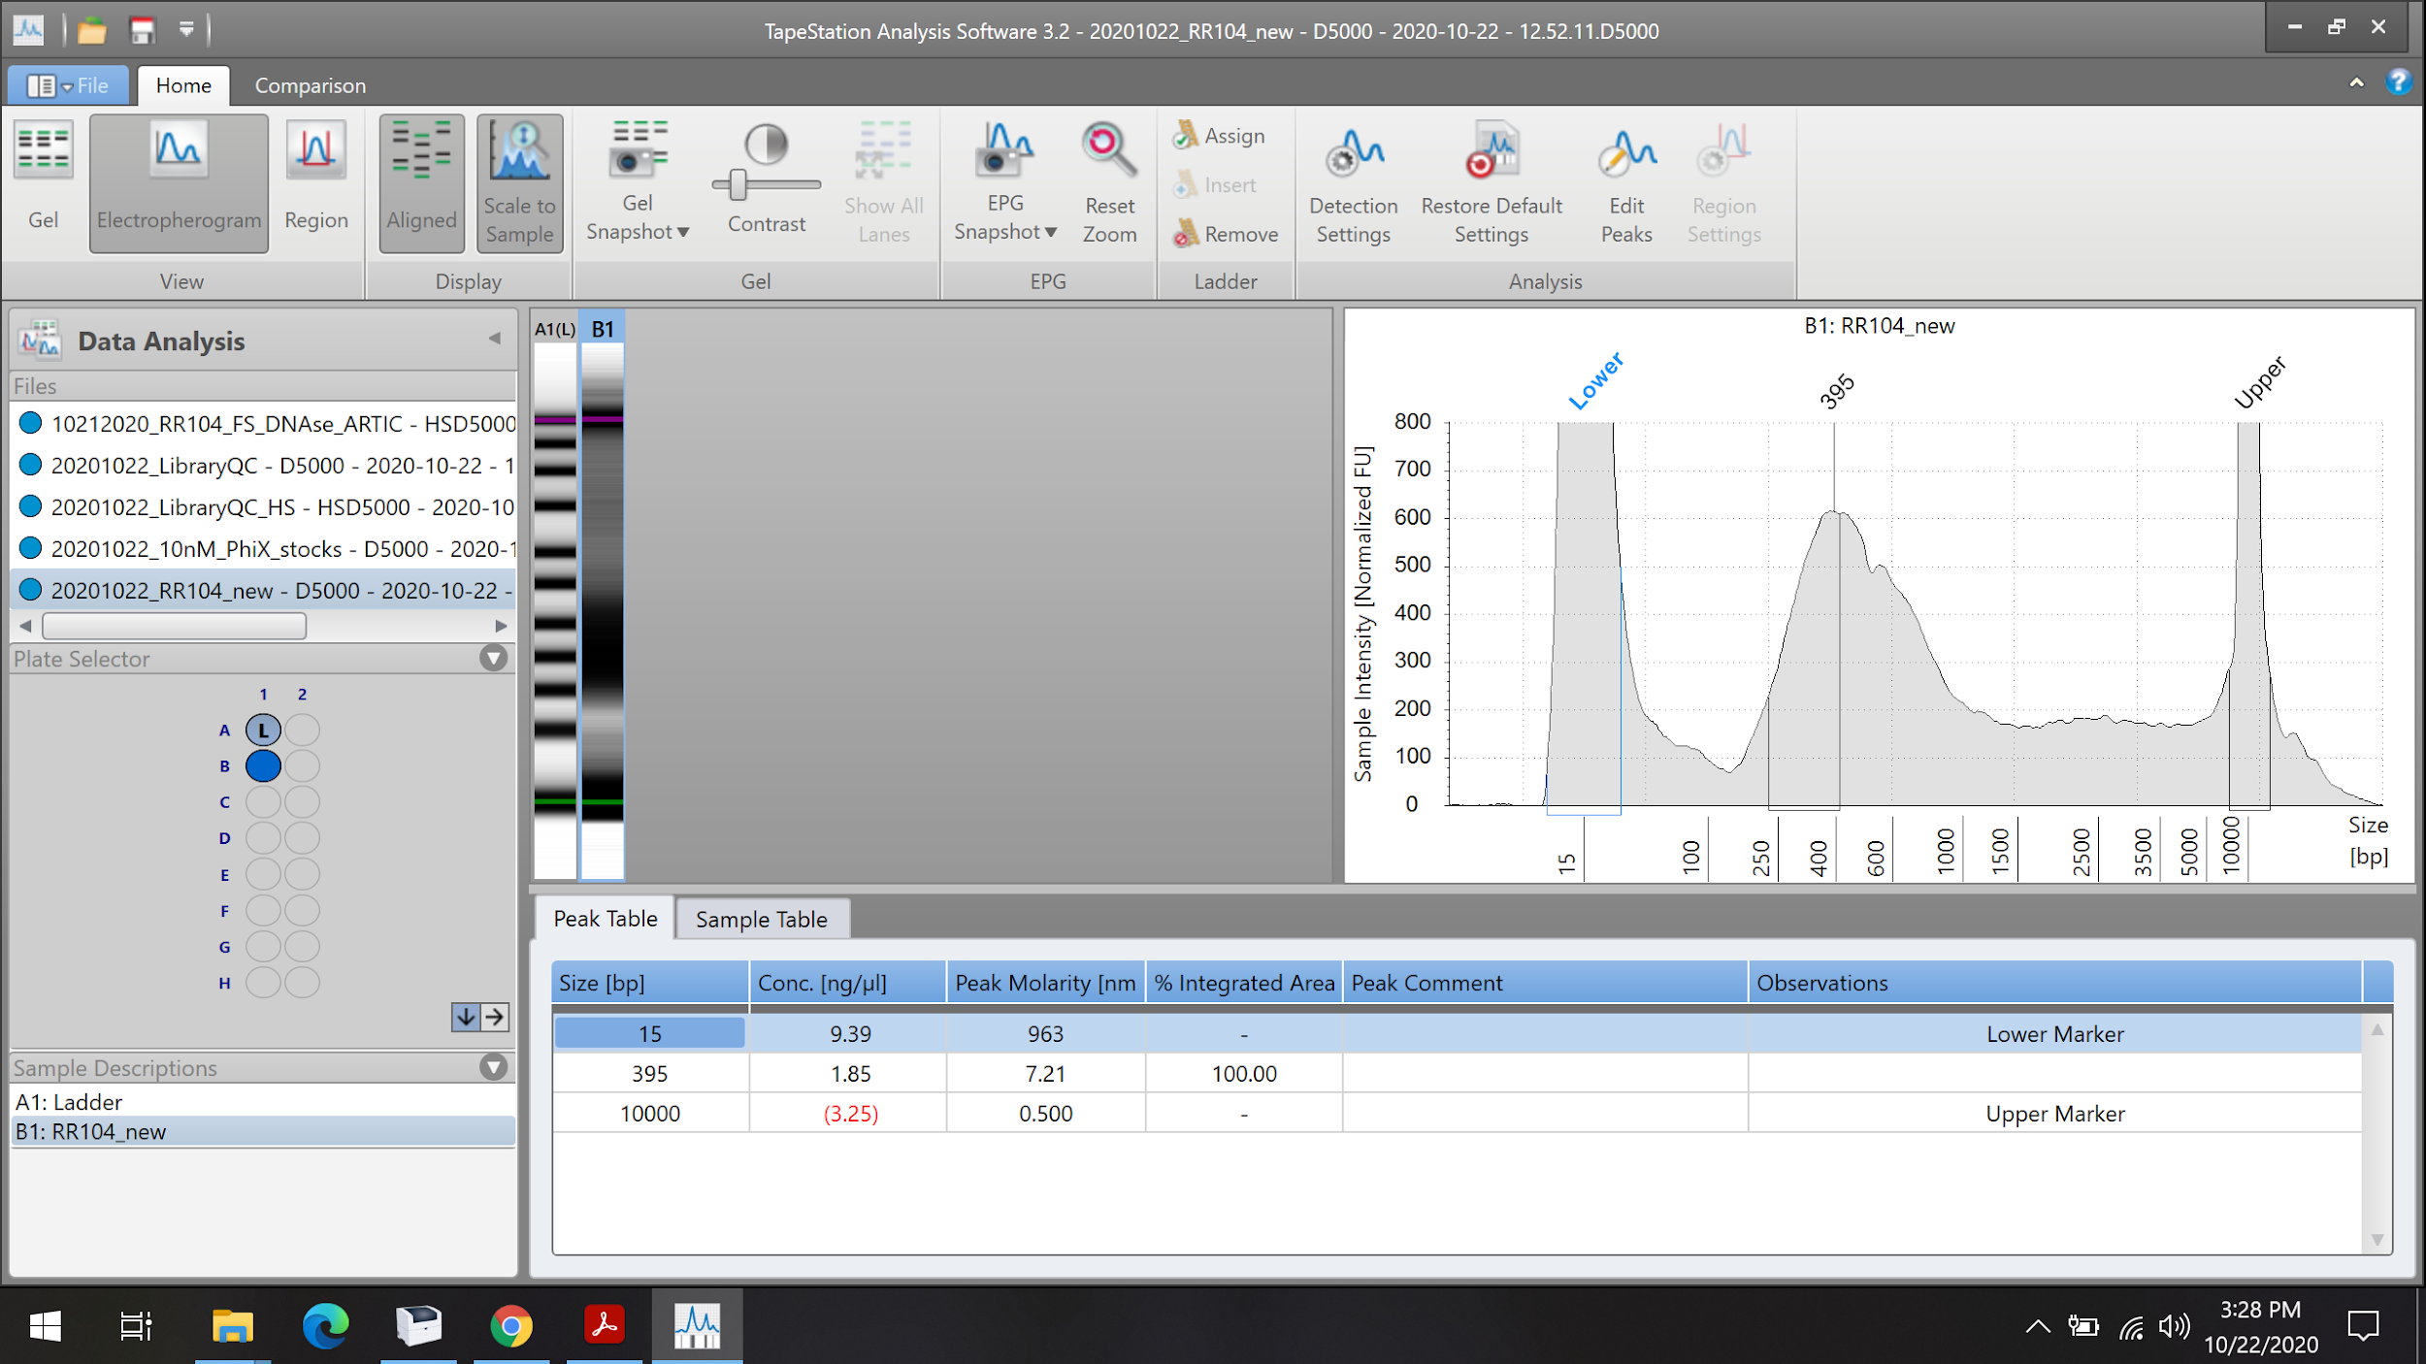
This is the “Electropherogram” view setting. If you see this after the TS analysis ends, click on “Region”

Slide 32
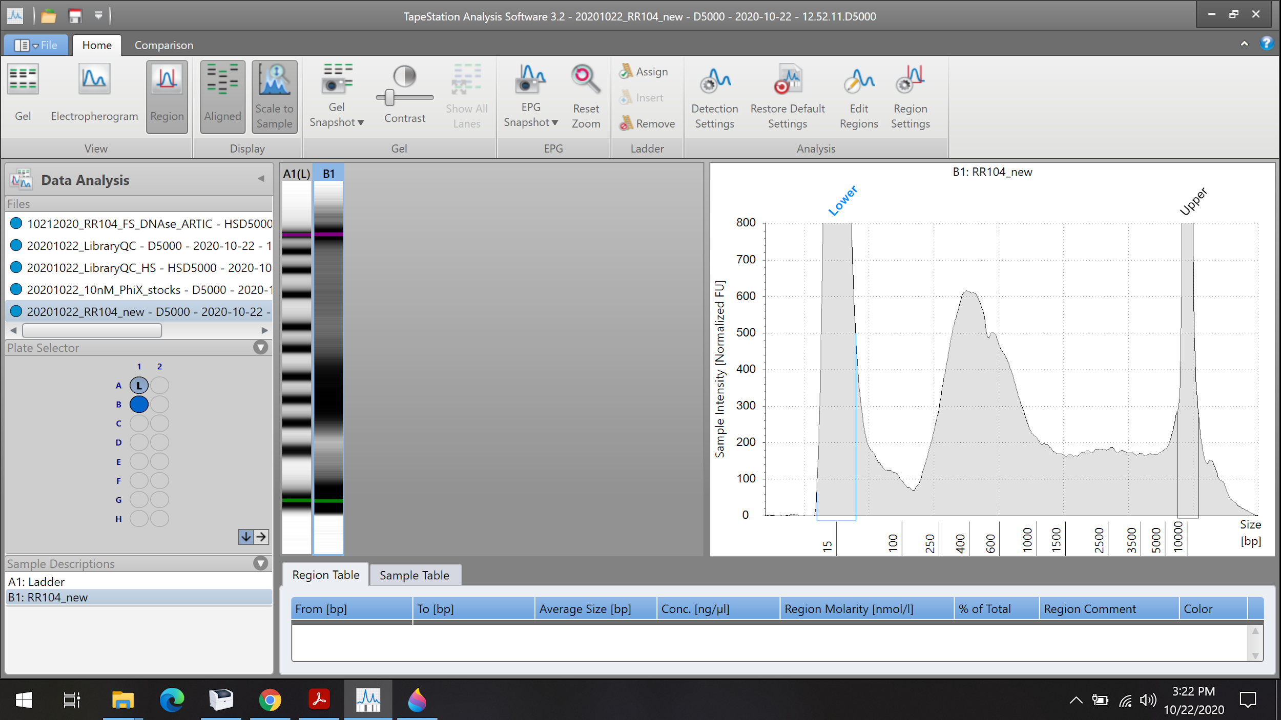
Click on “Region Settings”

Slide 33
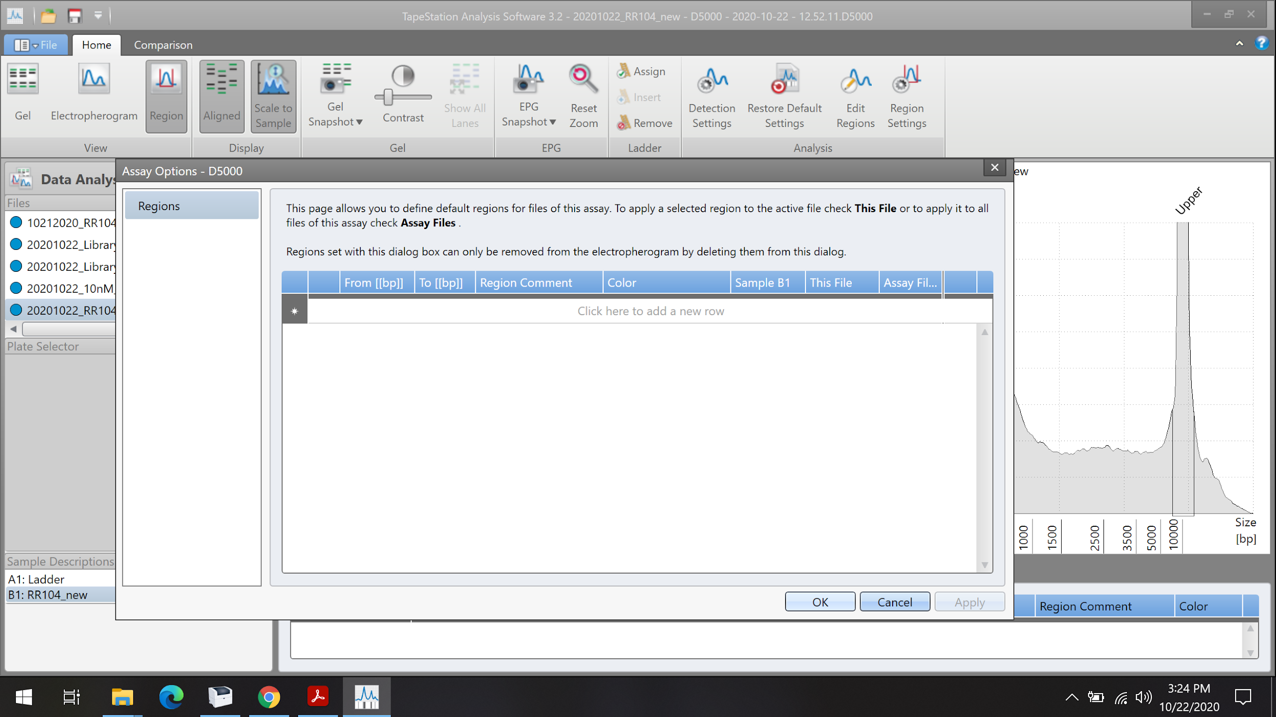
Click on this line to add the peak range of interest

Slide 34
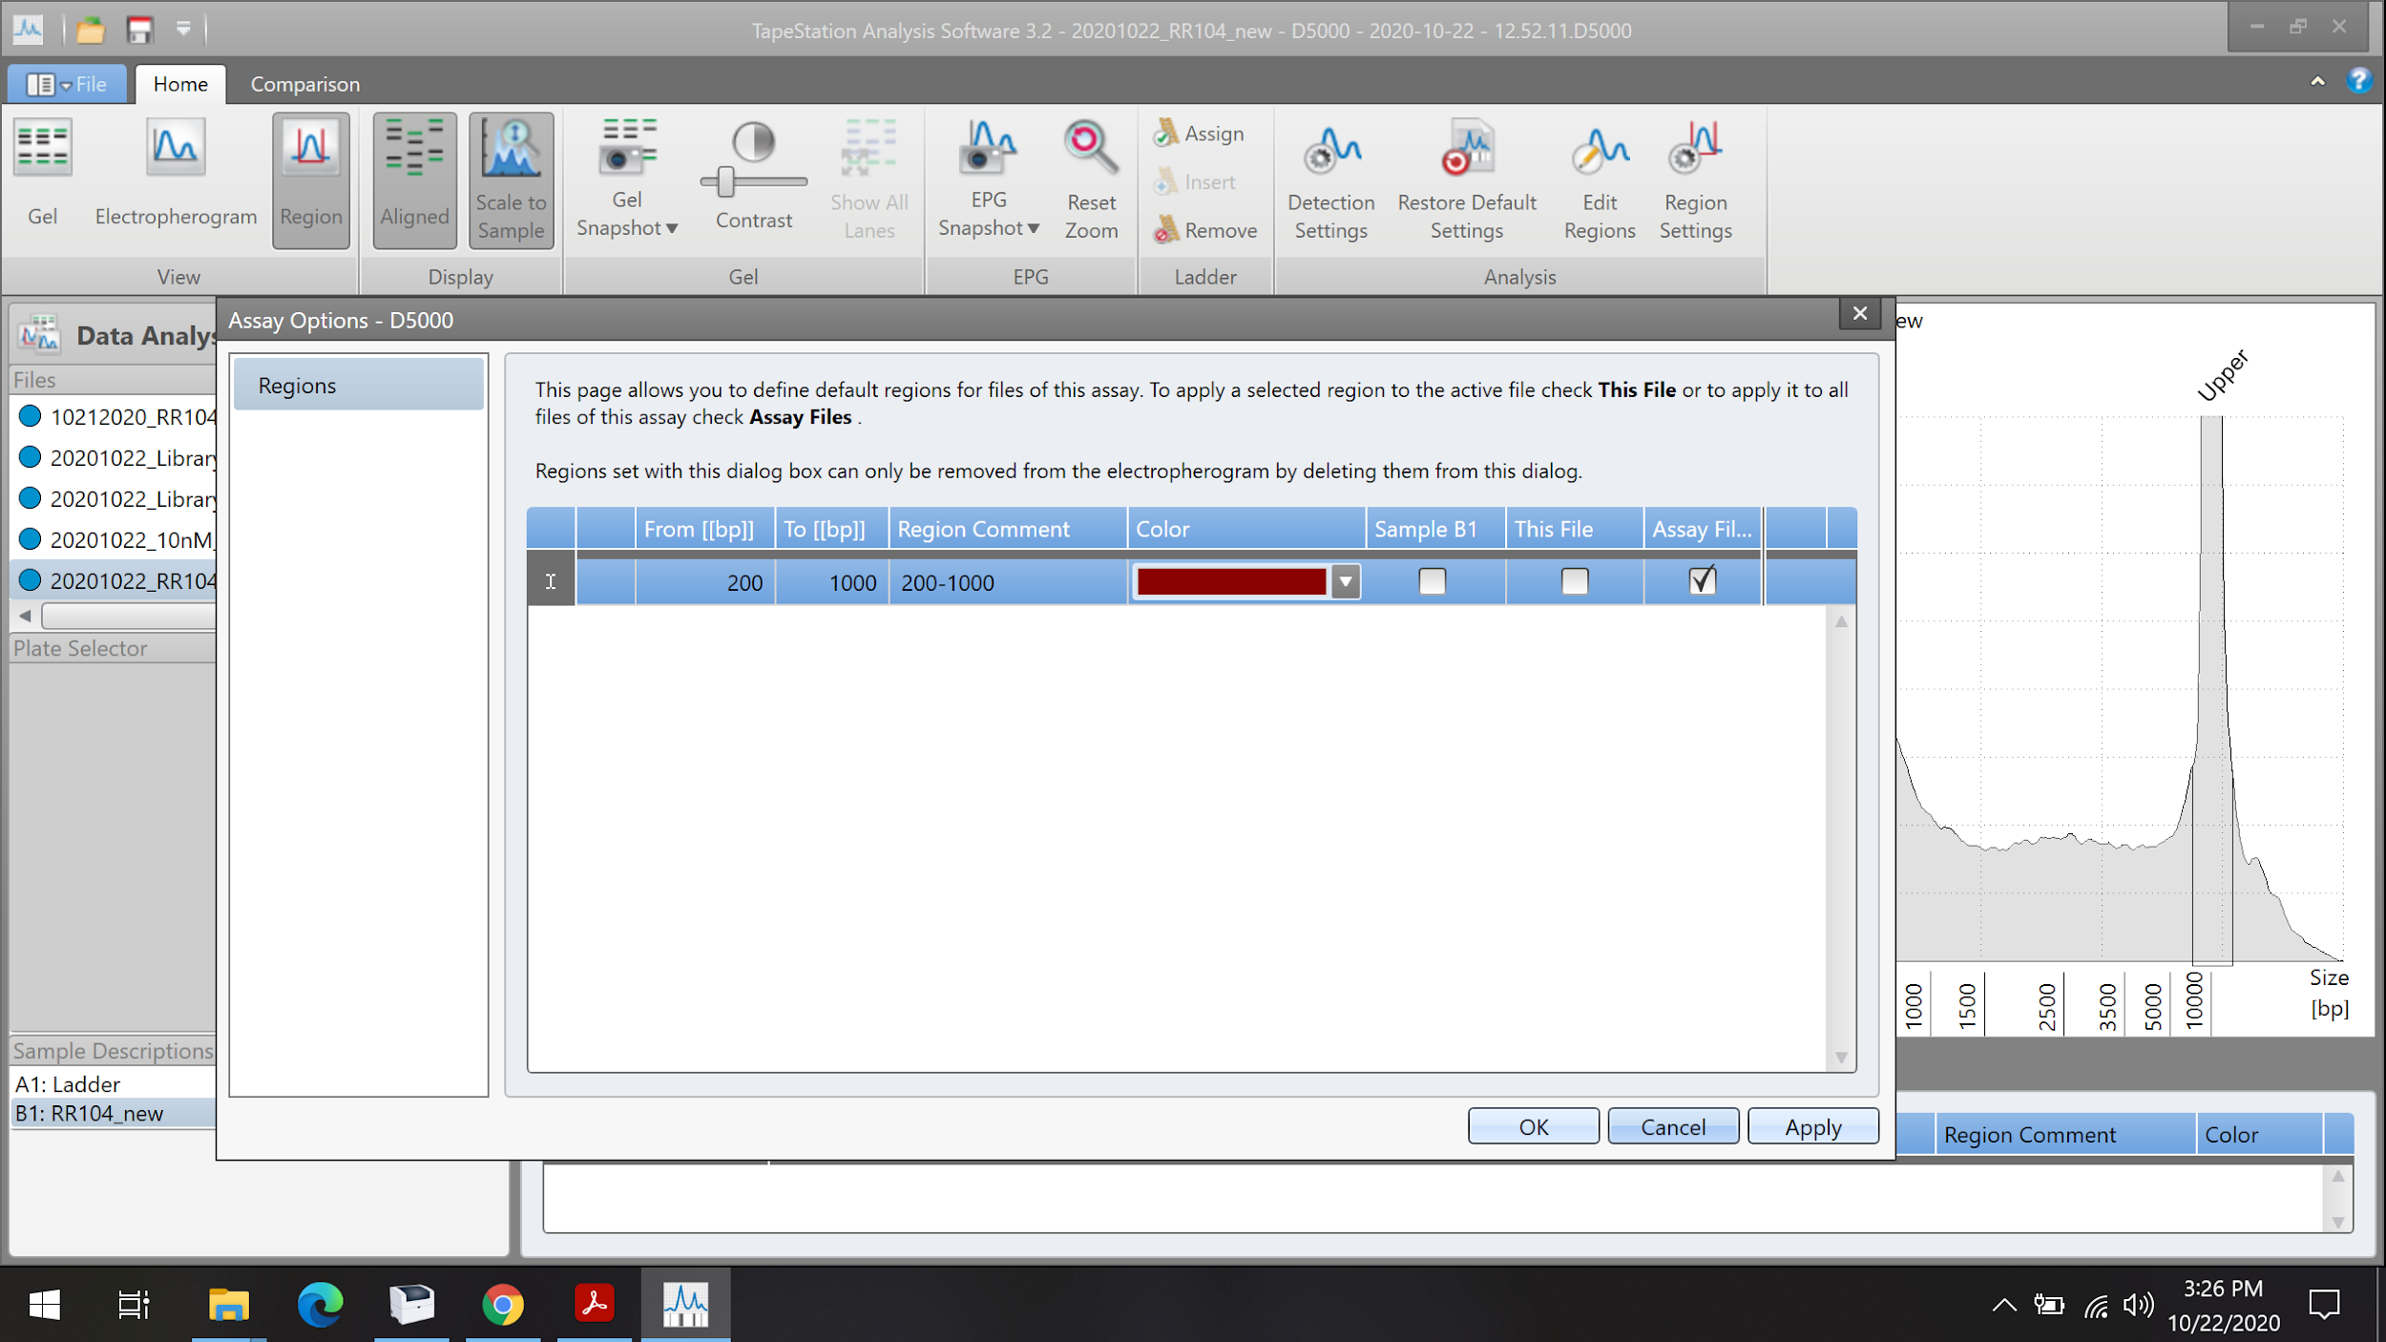
By selecting “assay file” this range will apply to all future assays. But you can also specify the range for a sample or file.
Enter the “from” and “to” range here. We commonly use the 200-1000 bp range
Notes:
You can set multiple peak ranges as well

Slide 35
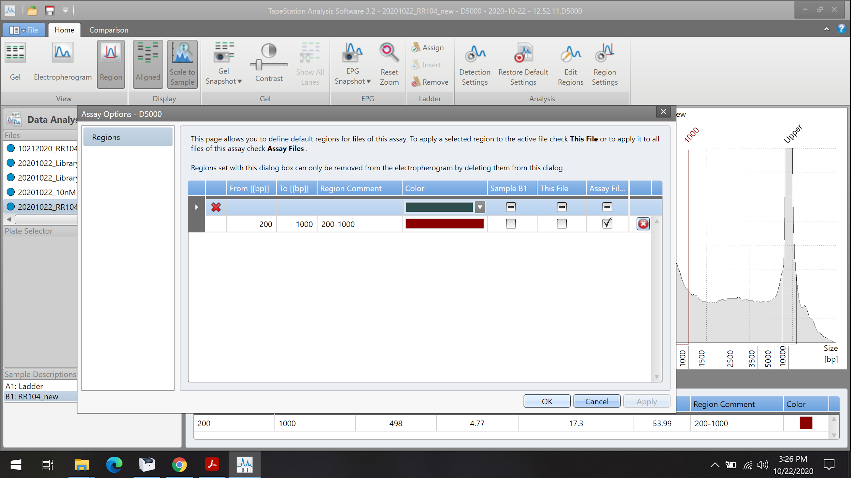
Click “Apply”

Slide 36
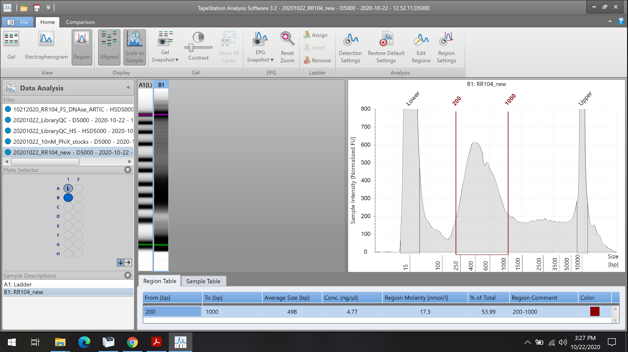
The “Region Molarity” concentration is now based on the 200-1000 bp range selected. This is the TS value that we use for our sample quantification

Slide 37
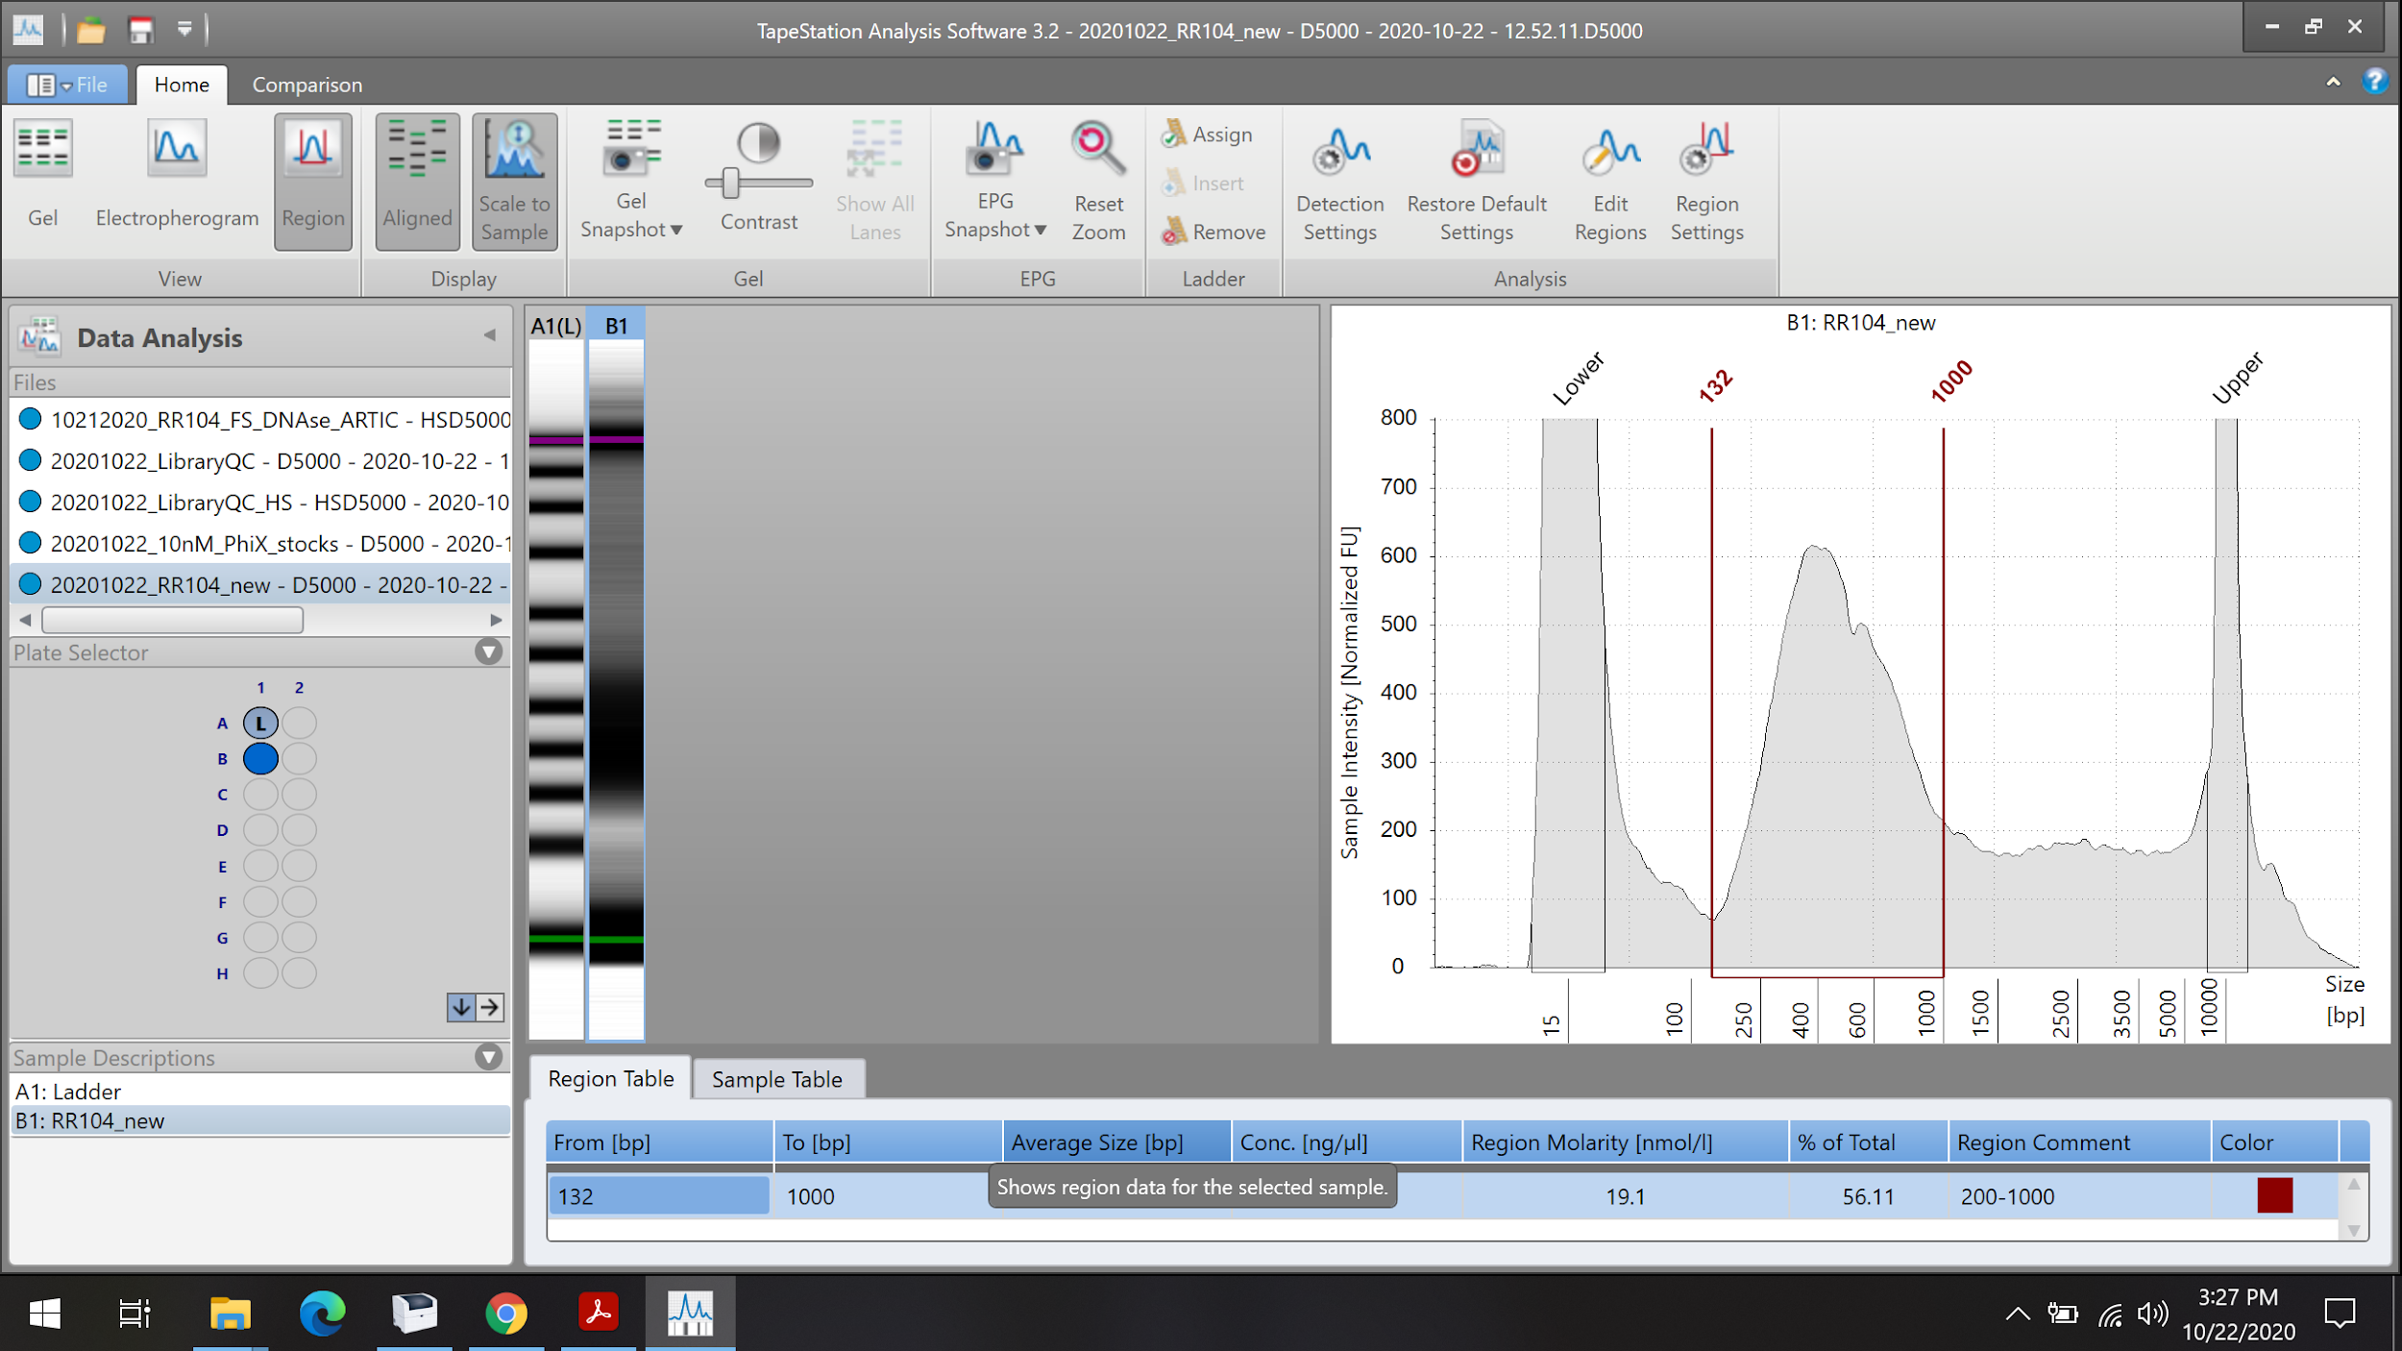
You can click and drag the peak range vertical line to make adjustments. In this case, we shifted the line from 200 bp to 132 bp to take into account shorter fragments. Region molarity is automatically recalculated.

Slide 38
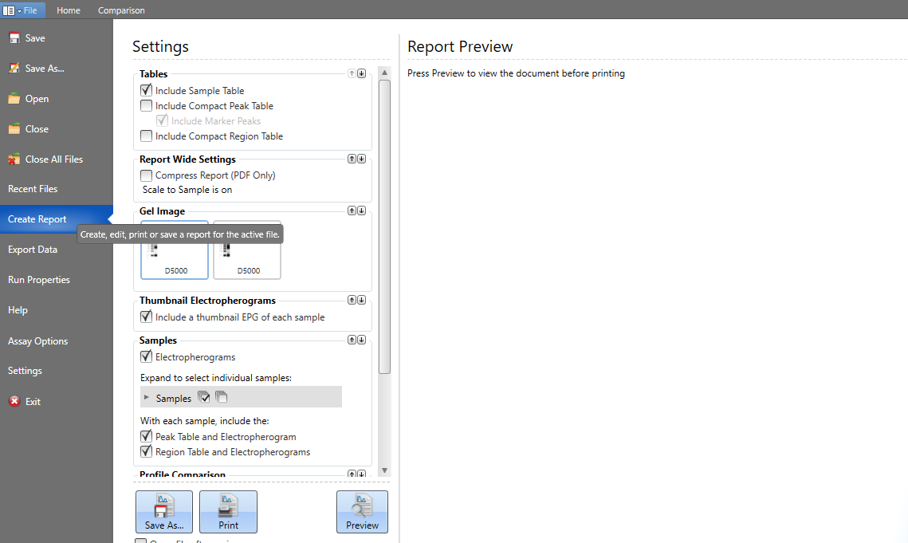
When you click on file this window will open. Click on “Create report” on the left panel in the purple box. That will create the report in pdf which is now you can save by clicking on “Save As…” in brown box. This will create the pdf report wich is amenable to view in other computers

Slide 39
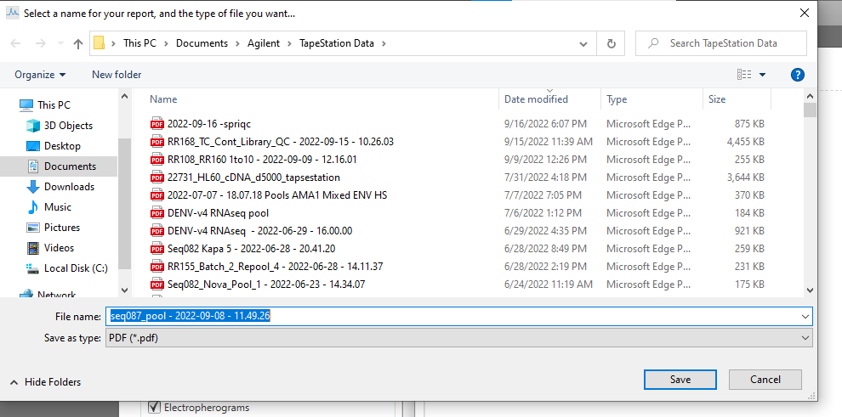
Save and now your report is ready to share as a pdf!

Slide 40
Next: 06-O_Oxford Nanopore sequencing

